Slide 1
start
Load Material/User
start
Load Structure/Structure List
recommended
k/ko max.
Tolerance
Recursive Limit
checkbox
Load Reference Purcell Factor
Calculate
Purcell factor
It is recommended to use the default settings.

Slide 2


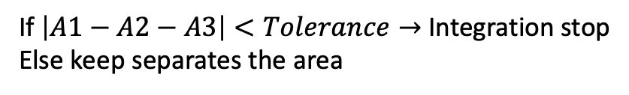
A. Points along kt/ko
Numerical Integration: A1
kt/ko max.
0
$$\frac{k_{t}}{k_{o}}$$
start points
B. Separate into two pieces
Numerical Integration: A2
kt/ko max.
Numerical Integration: A3
$$\frac{k_{t}}{k_{o}}$$
start points
start points
If $\left|A1−A2−A3\right|<Tolerance→$ Integration stop
Else keep separates the area

Slide 3
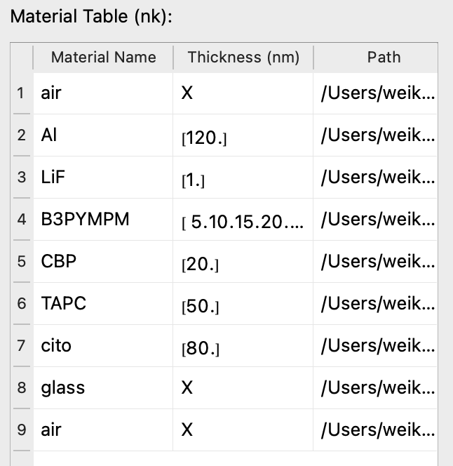
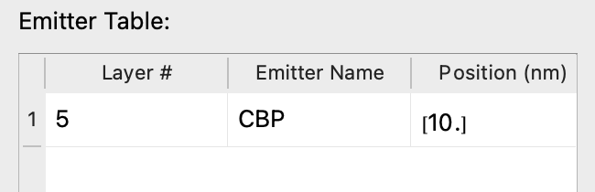
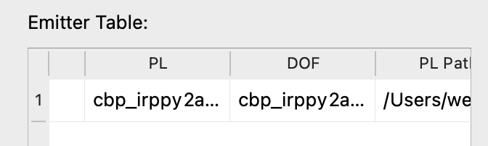
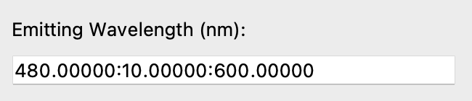
(a) device structure
(b) EML
(c) emitting wavelength

Slide 4
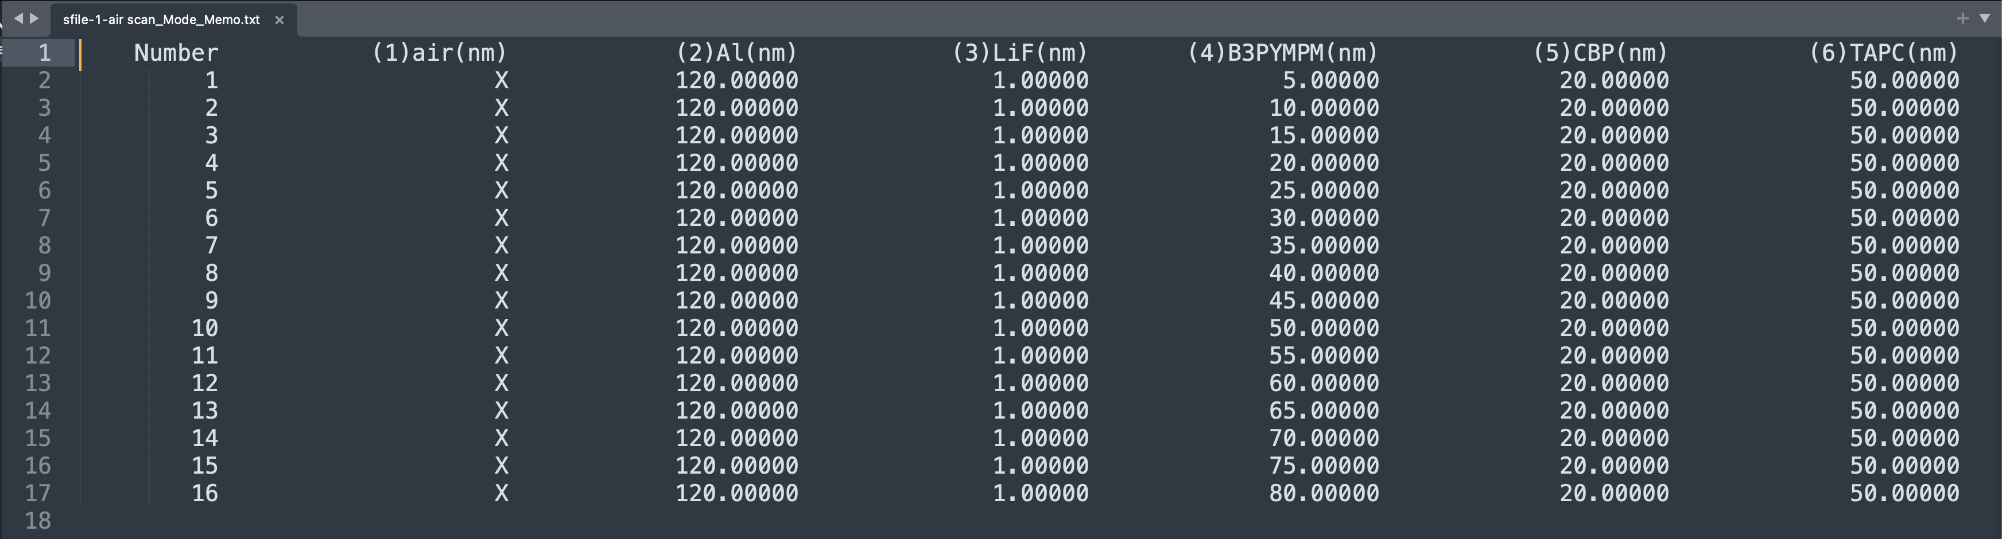
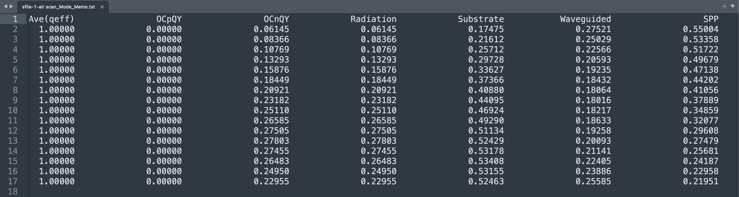
(a)
(b)

